Slide 1
Erikson’s stages of Psychosocial Development

Slide 2
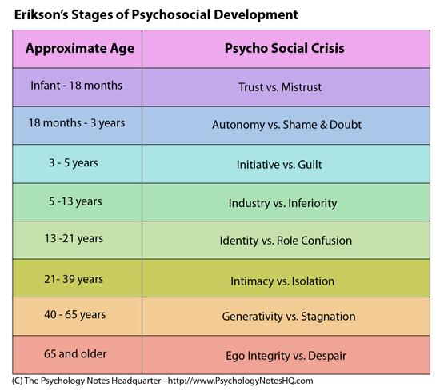
Erikson’s Stages
Erik Erikson proposed 8 stages
social of psychosocial stages or crisis
Erikson characterizes an individual
advancing through the eight life stages
as a function of negotiating his or
her biological forces and sociocultural
forces

Slide 3
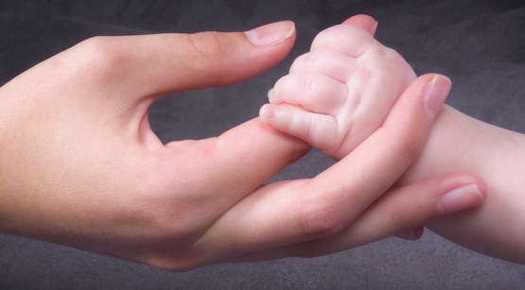
Stage 1: Trust and Mistrust (0-1)
Can I trust the world?

Slide 4
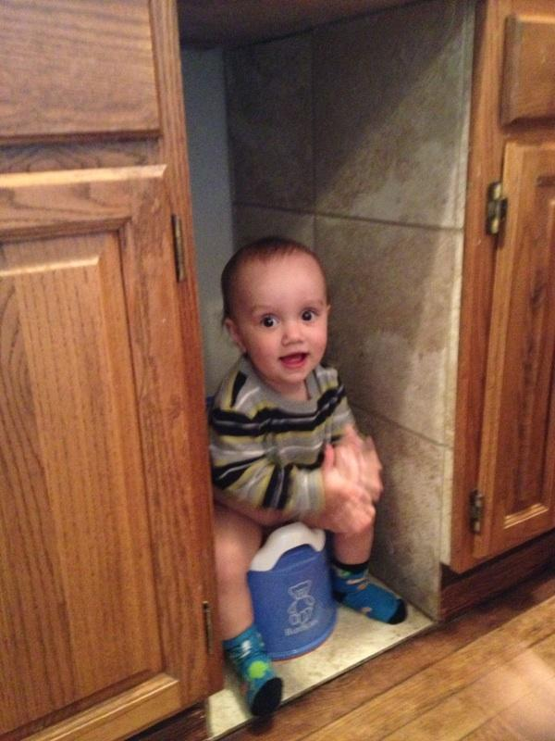
Stage 2: Autonomy and Shame (1-3)
Is it okay
to be me?

Slide 5
Stage 3: Initiative and Guilt (3-6)
Is it okay for me to do, move and act?

Slide 6
Stage 4: Industry and Inferiority (6-12)
Can I make it in the world of people and things?
School, Sports
Neighbors, School

Slide 7
Stage 5: Identity and Role Confusion (12-19)
Who am I? Who can I be?

Slide 8
Stage 6: Intimacy and Isolation (19-25+)
Can I love?
Romantic Relationships?
https://www.youtube.com/watch?v=nkslY_Fxw0Q

Slide 9
Stage 7: Generativity and Stagnation (25-50+)
Can I make my life count?
Work? Parenthood?

Slide 10
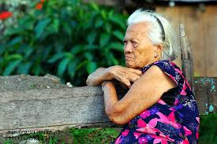
Stage 8: Integrity and Despair (50+)
Is it okay to have been
me?

Slide 11
Us as Teachers
Most of our students will be going through the Identity and Role Confusion stage.
In groups, discuss the experiences you had developing your identity.
Discuss how this will inform your teaching.

Slide 12
References
http://healthyrelations101.blogspot.com/2012/03/stages-of-development-school-age.html
http://pixgood.org/integrity-vs-despair.html
https://www.pinterest.com/pin/204210164326445306/
http://www.sheknows.com/parenting/articles/808232/teaching-kids-not-to-brag
http://wp.patheos.com.s3.amazonaws.com/blogs/deaconsbench/files/2012/01/Mother_baby_hand.jpg
http://darkroom.baltimoresun.com/wp-content/uploads/2012/05/AFP_Getty-145506589.jpg
https://www.pinterest.com/pin/162974080236889517/
http://images.moneymanager.com.au/2013/08/05/4629731/textawide-620x349.jpg
https://londonexternal.files.wordpress.com/2015/04/humanities1.jpg
http://images.popmatters.com/news_art/f/feature-mileyinterrupted-mileycyrus-500.jpg
http://onmilwaukee.com/images/articles/ha/hannahtix/hannahtix_fullsize_story1.jpg

